Slide 1



FloodSense AI.

Slide 2

- Understand the impact of climate risks on communities
- Analyze factors contributing to disasters
- Develop strategies for disaster preparedness and management
- Implement data-driven insights for risk reduction
GOAL
Source :
www.freepik.com/

Slide 3
- Python (Pandas, NumPy, Matplotlib, Scikit-learn)
- Google Colab
- Data Visualization Tools
- Machine Learning Models

Slide 4
- Data Collection & Preprocessing
- Risk Factor Analysis
- Predictive Modeling
- Visualization & Insights
- Policy Recommendations

Slide 5
Problem Statement:
Climate change has led to an increase in the frequency and intensity of natural disasters
such as floods, droughts, heatwaves, and cyclones. Many regions lack proper early warning
systems, disaster preparedness strategies, and data-driven risk assessments. This results in
severe socio-economic losses, displacement of communities, and long recovery times.
Without predictive models and effective management frameworks, it becomes challenging
to reduce risks, safeguard lives, and protect critical infrastructure.

Slide 6
Solution:
developed a data-driven disaster management framework that:
Uses predictive analytics to identify high-risk factors such as urbanization, deforestation, and poor drainage.
Employs machine learning models to forecast disaster likelihood and impact.
Provides visual insights and dashboards for decision-making.
Suggests actionable strategies for policymakers and communities to improve preparedness, reduce risks, and enhance resilience against climate-induced disasters.

Slide 7
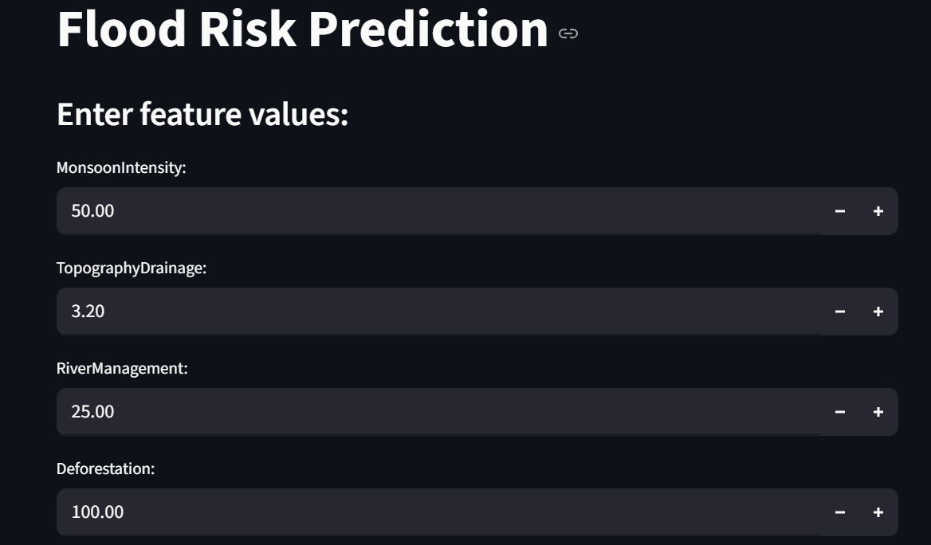
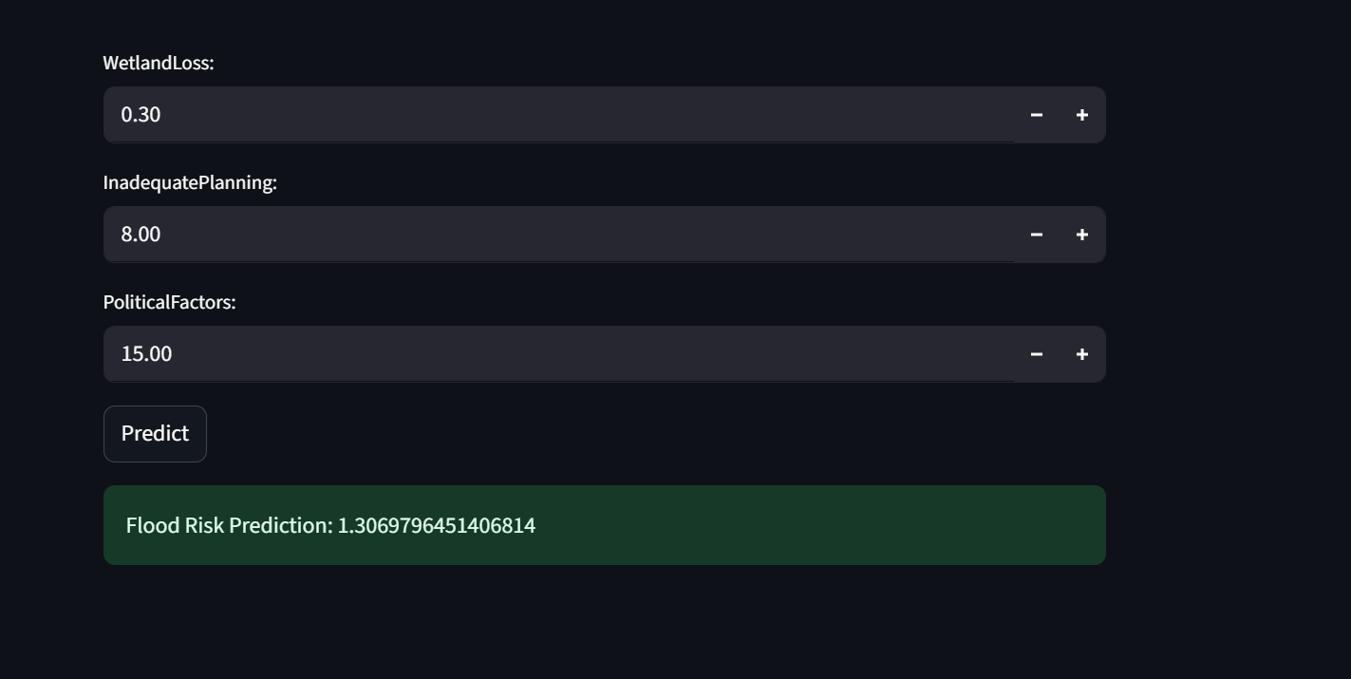
Screenshot of Output:

Slide 8
Conclusion:
Data-driven approaches can significantly improve disaster preparedness and risk reduction.
Predictive models help identify vulnerable regions and potential disaster triggers.
Visualizations and insights enable policymakers to make informed decisions.
Communities can build resilience, minimize losses, and recover faster from climate-induced disasters.

